Slide 1
Daybreak Elementary Kindergarten Orientation

Slide 2
Meat the Team
Leslie Ewell
Franco Preston
Jennine Jensen
Samantha Martinez
Principal
Assistant Principal
Kindergarten Teacher
Kindergarten Teacher

Slide 3
Agenda
Health Care Needs & State Requirements
Daybreak Office
Kindergarten Testing (KEEP)
Student Preparation for Kindergarten
Questions

Slide 4
Health Care Needs and State Requirements
State Law requires certain immunizations to be able to enter in to public school. Please bring a copy of your child’s immunization record to the office.
To attend Kindergarten, a student must have written proof of receiving the following immunizations:
5 DTaP/DT
4 Polio
2 Measles, Mumps, Rubella (MMR)
3 Hepatitis B
2 Hepatitis A
2 Varicella (chickenpox)
If you have any questions about immunizations, please contact of office!

Slide 5
Waivers
If you are unable to immunize your child or if you choose not to, you must get an exemption.
The Health Department has an online module that you can complete!
If there is an outbreak of a communicable disease in the school, and your child is not immunized your child will be required to stay home until the outbreak has passed.

Slide 6
Vision Screening
Good vision is important for learning.
Ask for a vision screening at your child’s next exam
We do vision screenings in the fall
Please let us know if you have any financial concerns. We can provide you with resources that may be able to help!

Slide 7
Medication at School
If your child needs to take medications while at school…
We need the proper forms in order to do so!
Medications are kept in the office unless your doctor signs forms that they are able to carry the medication with them (such as inhalers, epi-pens, and diabetic medication)
All medication must be checked in at the office by an adult
Please make sure to have the original packaging, pharmacy label, and that it is not expired!

Slide 8
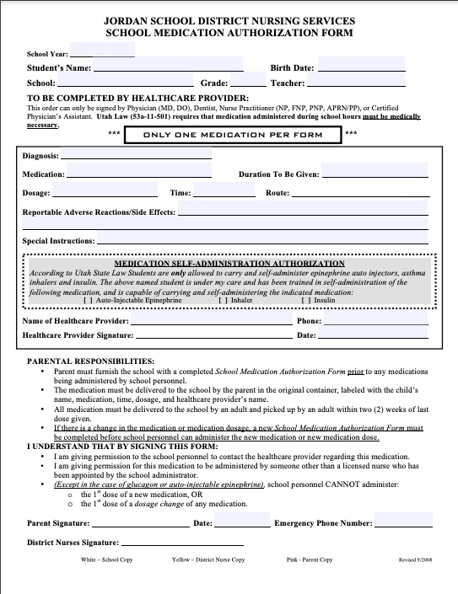
School Medication Authorization Form
This if the form you will need to fill out.
Grab one on your way out or from the office if your child will be needing it.
It can also be found on the Jordan School District Website under “Medication Guidelines”
Please contact us if your child has any medical needs that may require a health care plan. Additional forms will be required!

Slide 9
Daybreak Office 801-302-0553
What the office needs from you:
Register your student on the Daybreak Elementary Website
Bring in your child’s birth certificate
Immunization Records (even if you are not up to date!)
Proof of address
Parent’s Picture ID
AM/PM Class Preference (not guaranteed!)

Slide 10
Bell Schedule
PM Kindergarten:
Monday- Thursday
12:25- 3:05
Friday/ Early Outs
10:40-12:30
AM Kindergarten:
Monday- Thursday
8:30- 11:10
Friday/ Early Outs
8:30- 10:20
If your child is late, please be sure to check them in at the office. If they are going to be missing school for any reason, you can also contact the office to update their attendance.

Slide 11
Kindergarten Testing
Kindergarten students will be taking the KEEP (Utah’s Kindergarten Entry and Exit Profile) before they start school.
Watch for an email that will offer testing times. Testing begins August 22nd. The first day of Kindergarten is August 30th!
Students will take the test individually with their teacher
Please plan on the test taking about 20-30 minutes
We will have paperwork for you to fill out while you wait
Students will also complete individual testing in May at the end of the school year

Slide 12
Physical Preparation for Kindergarten
Here are some things you can do to help ensure your child is physically ready for Kindergarten.
Ensure they are able to take care of personal needs such as:
Putting on and tying shoes
Zipping up coats and jackets
Fasten and unfasten pants
Using the bathroom without assistance
Load and zip backpacks (please send them with a full size backpacks!)
Label personal items such as backpacks, coats, and water bottles.

Slide 13
Emotional Preparation for Kindergarten
Here are some things you can do to help ensure your child is emotionally ready for Kindergarten.
Make sure your child (and their teacher) know how they will get to and from school each day. Please contact the teacher if there are any changes!
If they ride a daycare bus, please make sure they know how to and where to get on the bus and what it looks like. Again, please let their teacher know if there are any changes.
For students safety, we cannot release students after school without a parent or sibling. Please make sure they know who they will be going with.
To help your child understand the time they will spend at school, set a time reference that they will understand such as “You will go to school after breakfast and be home in time for lunch.” Start talking with them about it NOW to help make the transition easier for them

Slide 14
Academic Preparation for Kindergarten
Here are some things you can do to help ensure your child is academically ready for Kindergarten.
How to use basic classroom materials appropriately (how to hold a pencil, drawing on paper, how to use scissors, etc.)
How to write the letters in their name
Counting to 20
Counting objects with 1-1 correspondence
Basic shape formation and recognition
Reading aloud to them and asking questions about the story
Understanding basic features of a story (where the words are in a book and reading from left to right)

Slide 15
Thank you! We are excited for you and your new Kindergartener to join our Daybreak Elementary family!

